Slide 1
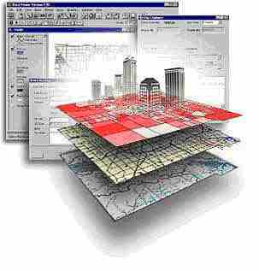
EMP 580
Topic:
What is a GIS?

Slide 2
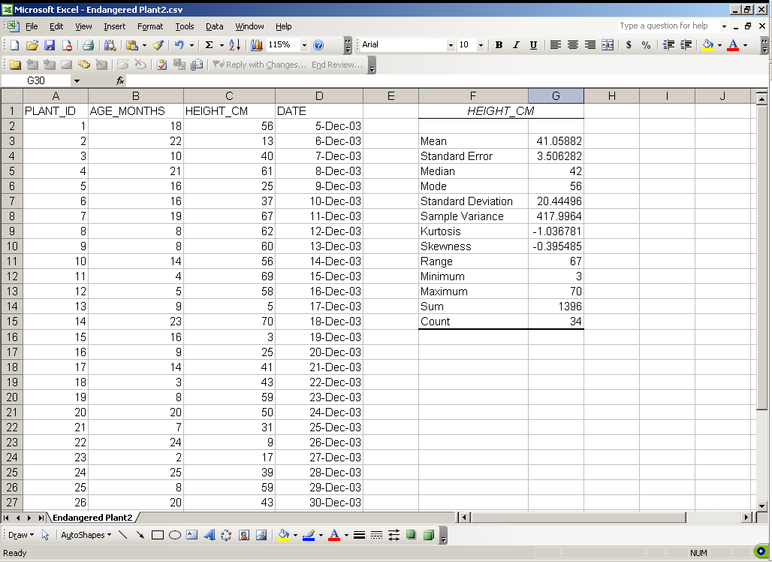
Aspatial Data

Slide 3
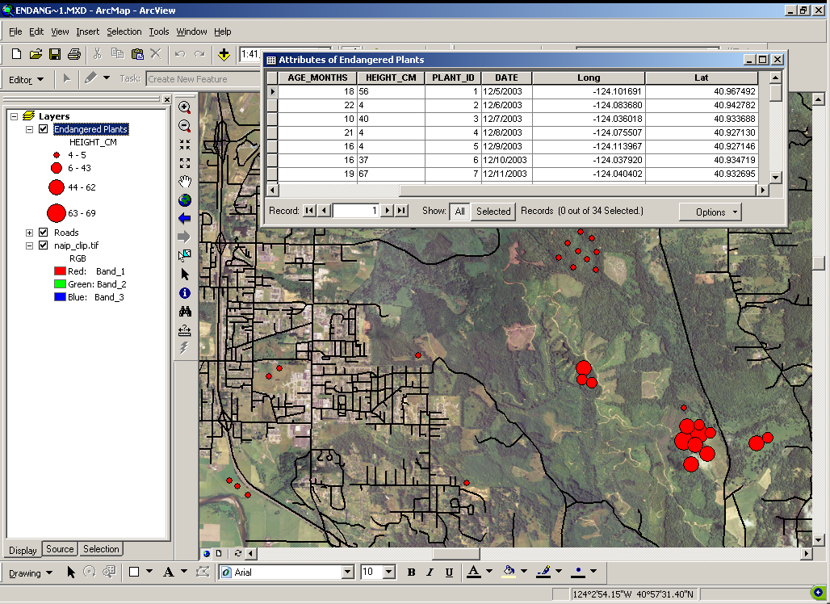
Spatial Data

Slide 4
What is a GIS?
Spatial Data:
  Data with a “spatial component” describing where something is located in on the earth.
Formal Definition of GIS:
  “A computer-based system to aid in the collection, maintenance, storage, analysis, output and distribution of spatial data and information (Bolstad, 2008)”

Slide 5
Elements of GIS
Collection: Internet, web services, GPS…
Maintenance: Quality control, metadata…
Storage: Files, folders, databases…
Analysis: Too many to list!
Output: Maps, tables, reports, pubs…
Distribution: Websites, web services…

Slide 6
Which of these are a GIS?
MS-Word
Excel
ArcGIS
Handheld GPS
GoogleEarth
MapQuest
Facebook
Twitter
Your cell phone
Your computer
You!

Slide 7
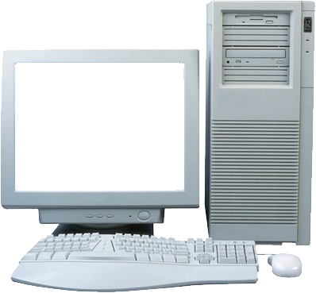
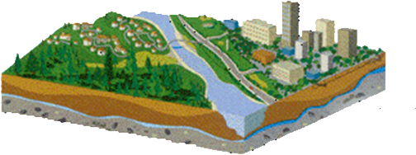
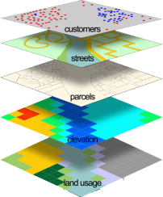
Modeling the real world
A world of physical entities that occupy space:
(plants, trees, rivers, streets, etc.)
  What: What are the physical features of interest
    and what are their properties and attributes?
  Where: Where are these physical features located, both in terms of their absolute locations (i.e., their coordinates) and their locations relative to other physical entities (their topology)?
  When: When are certain conditions true and how do things change over time

Slide 8
What is a GIS?
G
eographic: Geography is the scientific study of the locational and spatial variation in both physical and biological phenomena on Earth. (the “where”)
nformation: A collection of facts or data. (the “what”)
ystem: A group of interrelated parts working together (hardware, software, data, people…).
I
S

Slide 9
Get Answers to Questions
What exists at a certain location?
Where are certain conditions satisfied?
What has changed in a place over time?
What spatial patterns exist?
How close are things to one another?
What if this condition occurred at this place?

Slide 10
Questions from Managers
When and where should we:
  Spray for weeds?
  Build roads?
  Patrol for poachers?
  Protect habitat?
  Reintroduce species?
  Harvest?
  Monitor?
  Allow off-roading?

Slide 11
What can I do with a GIS?
With a GIS and spatial data you can ask spatially related questions:
The spatial distribution of object(s) or theme(s)
    Where is x? How is x distributed?
The relationship between the spatial distribution of objects or themes
    Where is x in relationship to y?
The association of objects or themes in an area.
    Is there a correlation between the distribution of X and the distribution of Y? Could X be causing Y?
Spatial Analysis!

Slide 12
GIS Is About:
Acquiring Spatial Data – representing things on the earth
Evaluating – making sure data fits use
Analysis – turning data into information
Cartography – the creation of maps
Dissemination – distributing maps, data, and results
Documenting – ensures future use

Slide 13
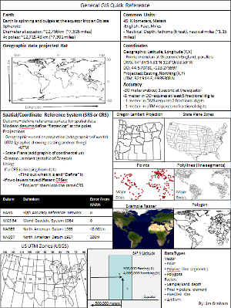
GIS Resources
There are many resources:
  The web, classes, books, organizations, individuals
See Jim’s professional website for more:
  (http://gsp.humboldt.edu/JimsProfessional/Resources.html)
  You’ll want to know everything on the quick reference

Slide 14
The Bigger Picture
Geospatial Sciences
GIS
Remote Sensing
GPS
Cartography
More…
Geodesy
Geospatial Sciences: The science and technology of gathering, analyzing, interpreting, distributing, and using geographic information.

Slide 15
GIS is almost everywhere
Wildlife
Forestry
Geology
Spatial Management
Navigation
Transportation
Security
Atmospheric Sci.
Oceanography
Anthropology
Biogeography
Environmental Sci.
Tourism
Economy
Policy
Social Science
And more…
General GIS:
Data acquisition, management, analysis, and representation
Basic concepts, skills, knowledge

Slide 16
Key Points
A GIS is not just a computer program for making maps.
It is, first and foremost, a powerful analytical tool with a spatial “awareness” that allows you to analyze spatial data and answer complex spatial questions.

Slide 17
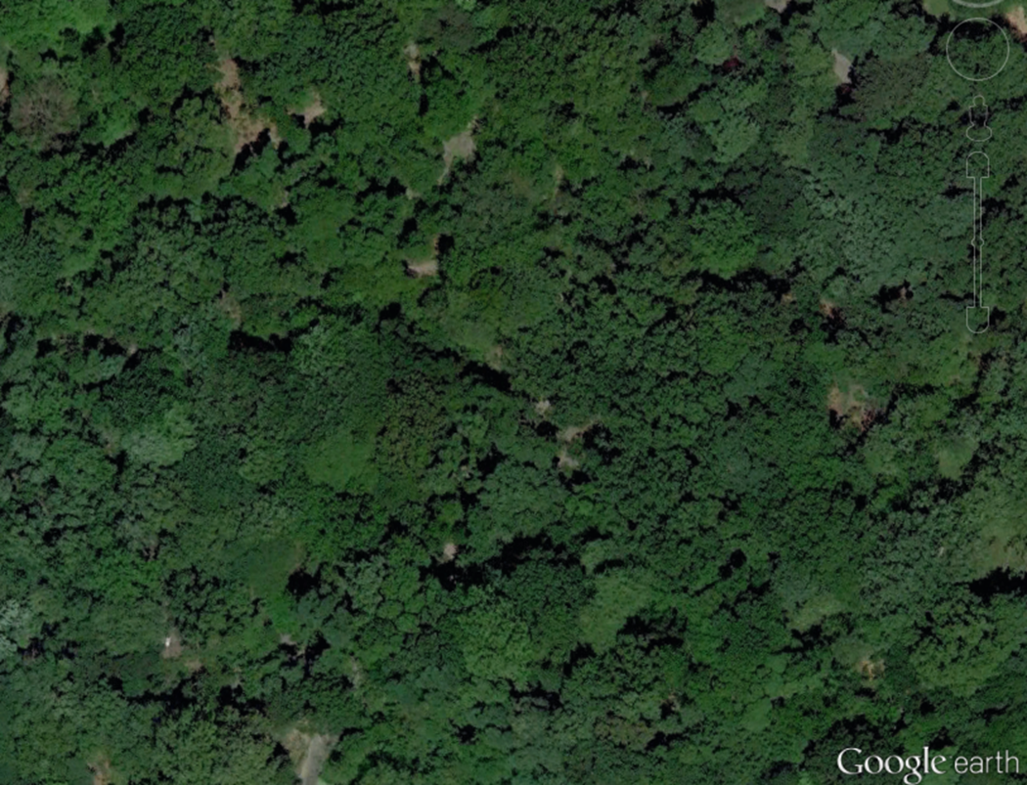
Where are we?

Slide 18
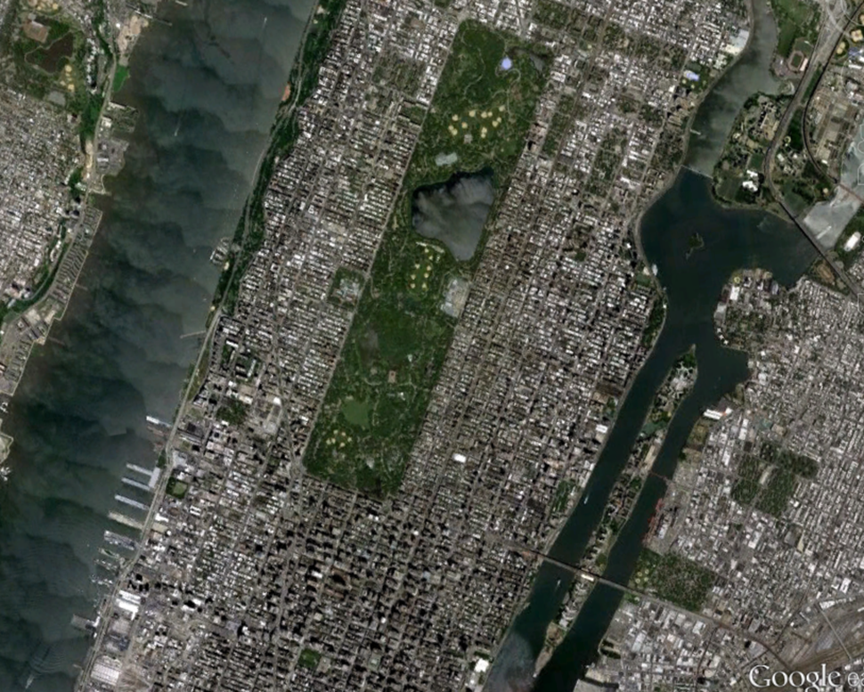
GIS can broaden your view!

